Slide 1

Microsoft Ignite NZ
25-28 October 2016
SKYCITY, Auckland

Slide 2
A lap around Azure Active Directory Business to Consumer (B2C)
Session Code
Rory Braybrook
Girisha Arora
@rbrayb
@GirishaArora

Slide 4
Azure Active Directory B2C helps you to guard your external users in an ever evolving threat landscape

Slide 5
Contents
Overview
Policies
OAuth
Easy Auth
User Types
Graph Explorer
Fit?
Pros/Cons

Slide 6
Overview

Slide 7
What’s the use case

Slide 8
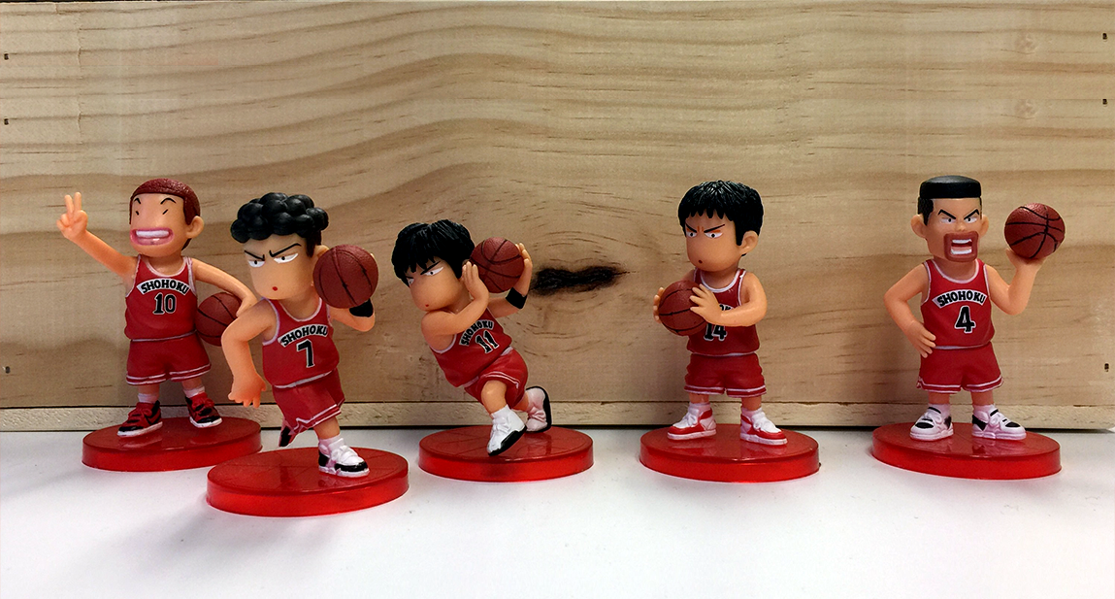
Basketball Store

Slide 9




External Users

Slide 10

Self-registration

Slide 11

Self Service Password Reset

Slide 12

Local Account

Slide 13





Use Social Account

Slide 14

Scale Out-of-Box

Slide 15

Your identity system has to be available 24/7
High Availability

Slide 16

If you have a list of names and passwords in your app, you’re a target
Many people use the same username and password with multiple apps
Secure and Reliable

Slide 17
Roll your own

Slide 18

Code

Slide 19

Code
Registration

Slide 20

Code
Registration
Social

Slide 21

Code
Registration
Social
MFA

Slide 22

Code
Registration
Social
MFA
cost

Slide 23
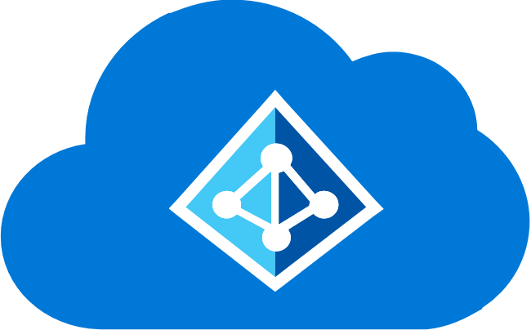
Azure Active Directory B2C

Slide 24
Officially called “B2C Basic”
GA since 28th July, 2016
Will also have B2C Premium – no details to date
Current State

Slide 25
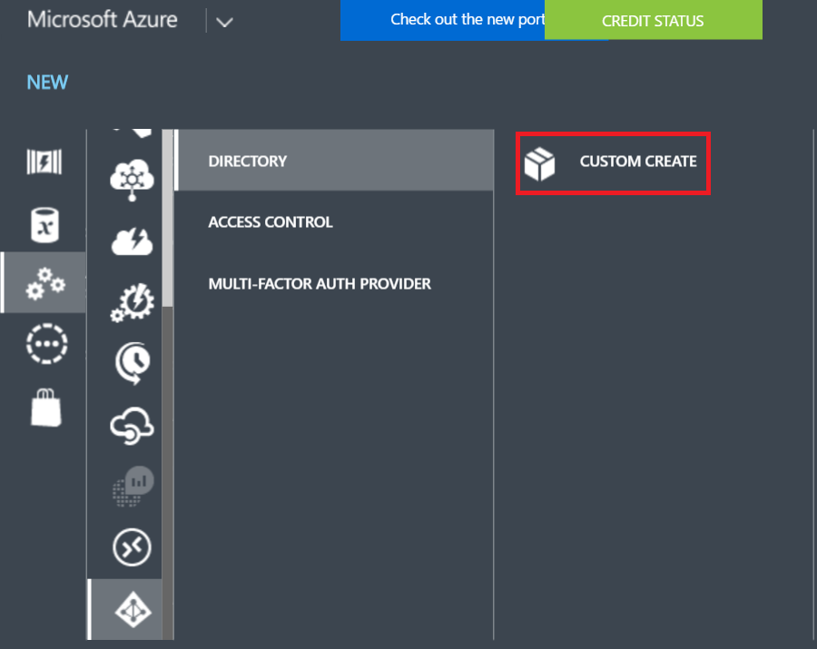
Creating a B2C tenant

Slide 26
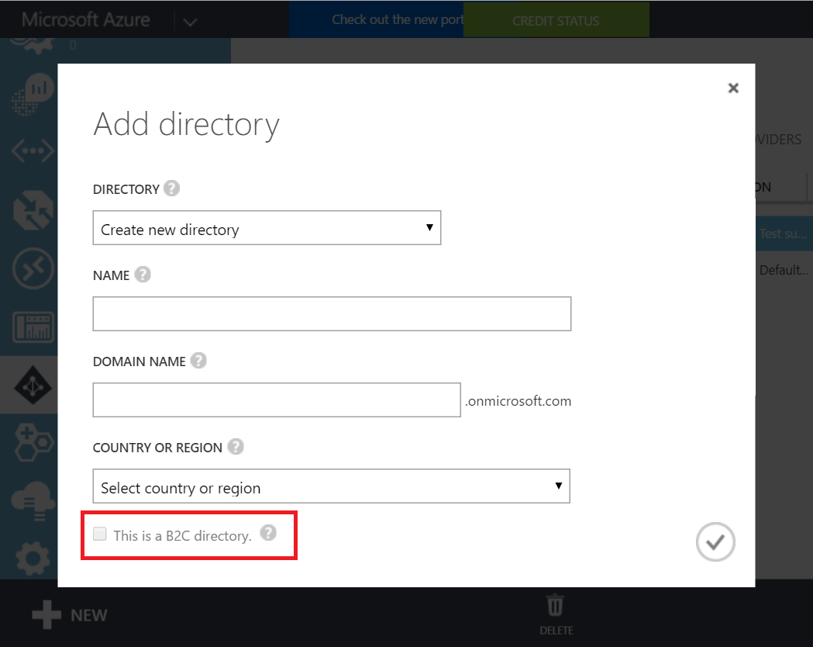
Creating a B2C tenant

Slide 27
Policies
YOUR APPLICATION

Slide 28
Policies
YOUR APPLICATION
SIGN-UP

Slide 29
Policies
YOUR APPLICATION
SIGN-UP
SIGN-IN

Slide 30
Policies
YOUR APPLICATION
SIGN-UP
SIGN-IN
SIGN-IN & SIGN-UP

Slide 31
Policies
YOUR APPLICATION
SIGN-UP
SIGN-IN
SIGN-IN & SIGN-UP
PROFILE EDITING

Slide 32
Policies
YOUR APPLICATION
SIGN-UP
SIGN-IN
SIGN-IN & SIGN-UP
PROFILE EDITING
PASSWORD RESET

Slide 33

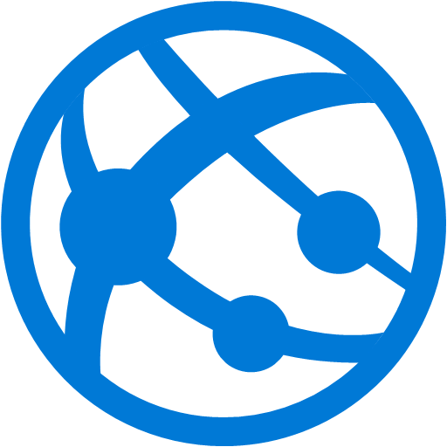
Map Policies
Applications
Identity Providers
User Attributes

Slide 34
OIDC / OAuth 2.0

Slide 35
Extended OAuth 2.0
GET https://login.microsoftonline.com/x.onmicrosoft.com/oauth2/v2.0/authorize
?p=b2c_1_sign-in-email
&client_id=6b6…d1e6f9f2
&redirect_uri=https://localhost:123456
&response_mode=form_post
&response_type=id_token
&scope=openid
&…

Slide 36
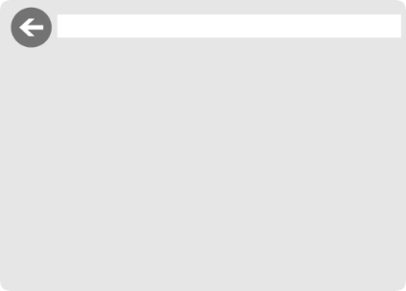

App level policy configuration
SignUp-1 policy
SignUp-2 policy
…
As needed
SignUp-n policy
SignIn-1 policy
App1 Application
…
App2 Application
As needed
SignIn-m policy
ProfileEditing-1 policy
…
As needed
ProfileEditing-p policy

Slide 37
Demo
Walk-through (with .NET core app)

Slide 38
Summary

Slide 39
Sign up, Sign in, Password reset & other policies

Slide 40
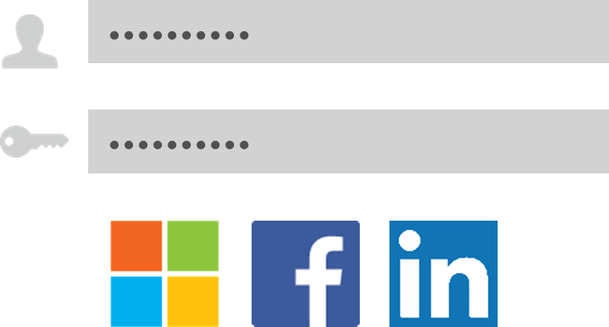


Social & Local Accounts

Slide 41
Easy Auth

Slide 42
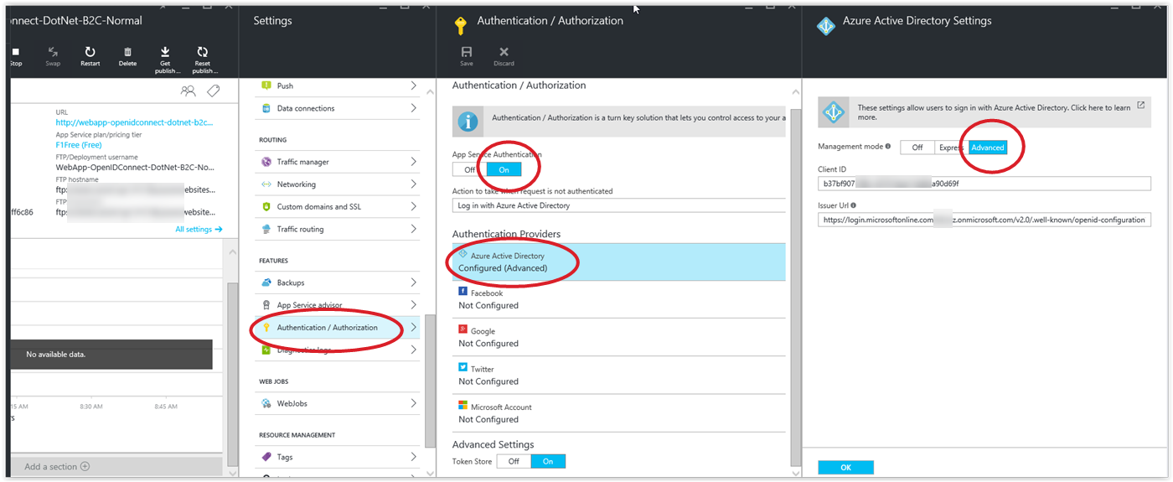
Configure

Slide 43
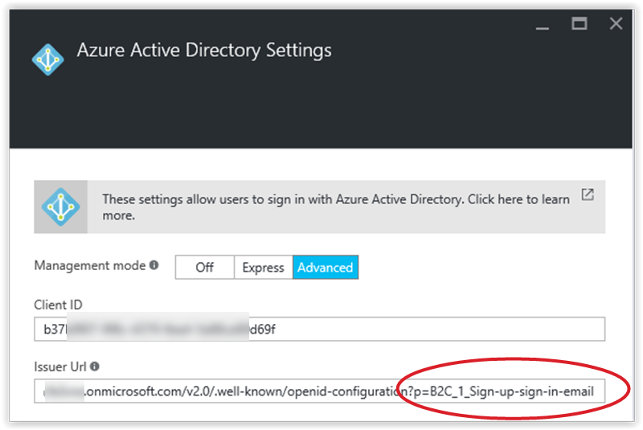
Internal tenant details

Slide 44
B2C User Types

Slide 45
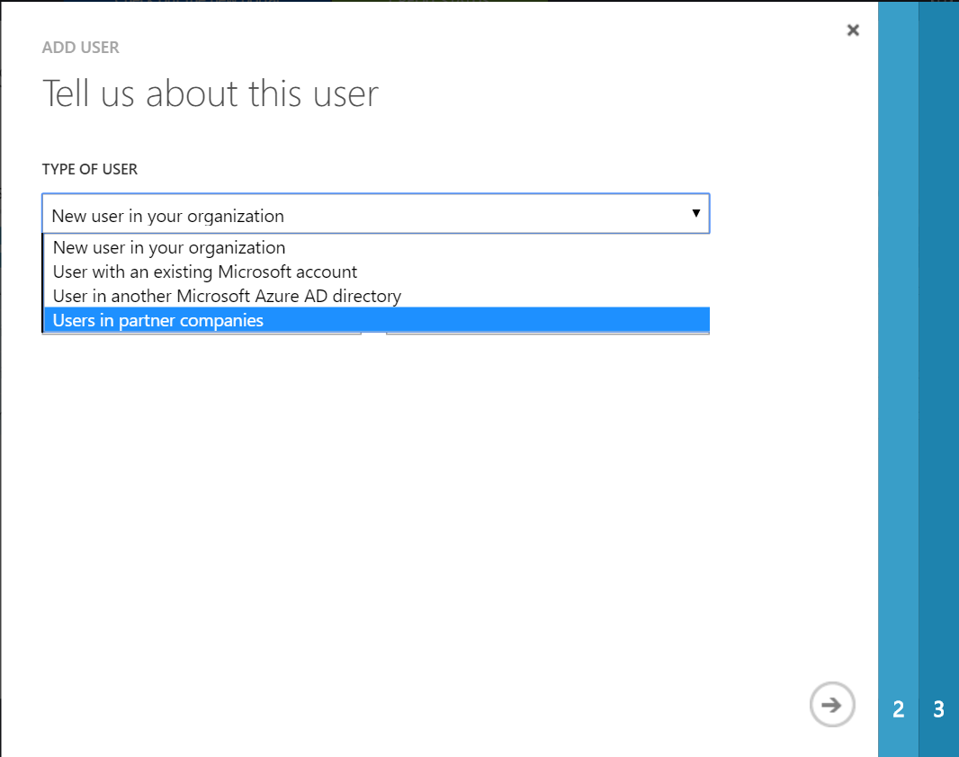
Add a user from the portal (Admin)

Slide 46
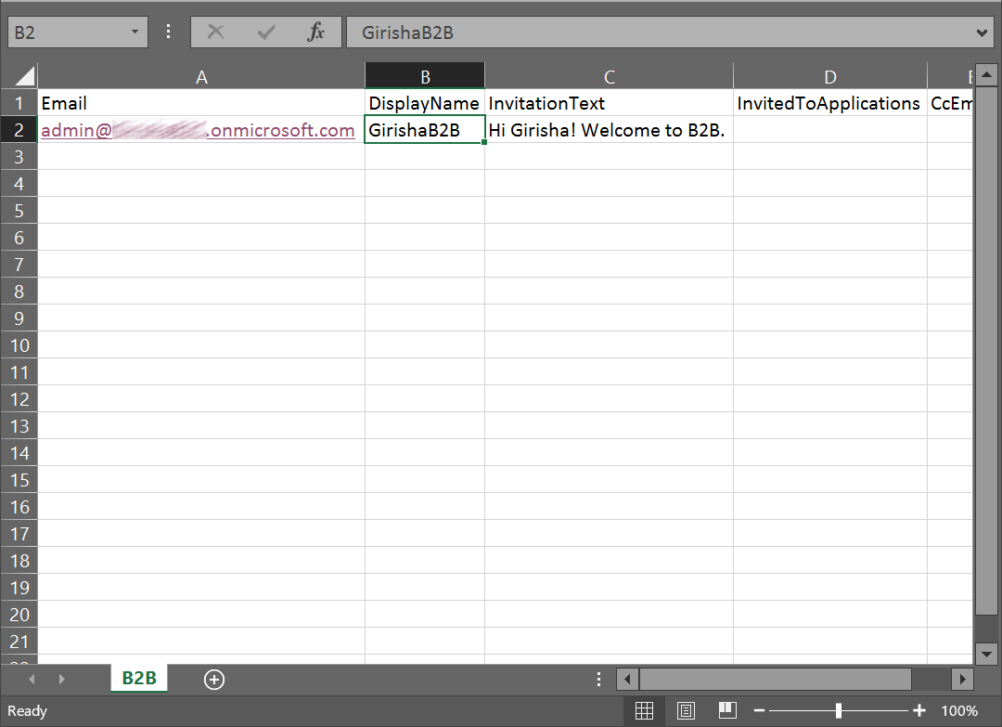
Using Business to Business (B2B)

Slide 47
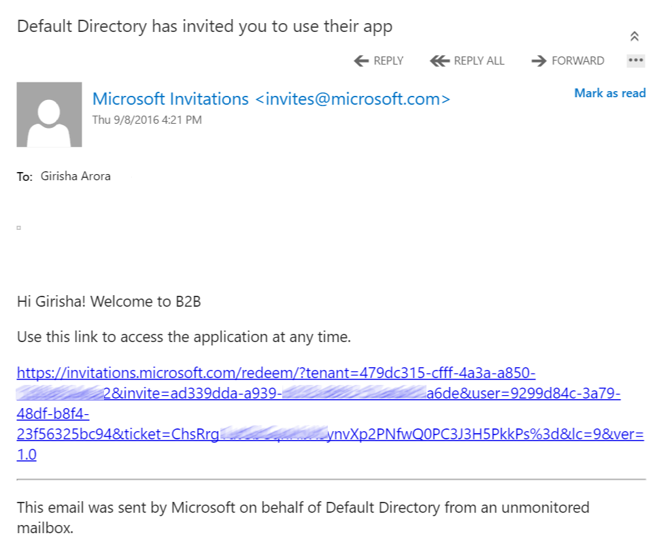
B2B invitation email

Slide 48
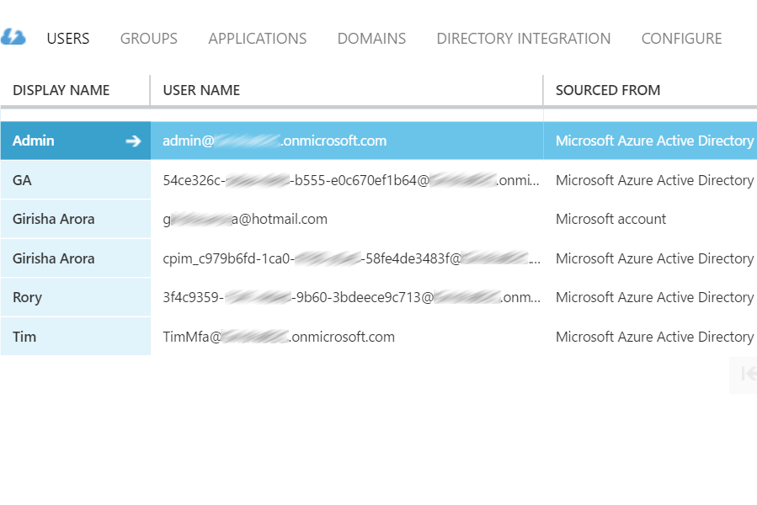
User formats

Slide 49
User formats

Slide 50
User formats

Slide 51
User formats

Slide 52
User formats

Slide 53
User formats

Slide 54
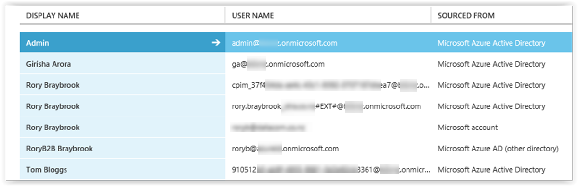
User formats

Slide 55
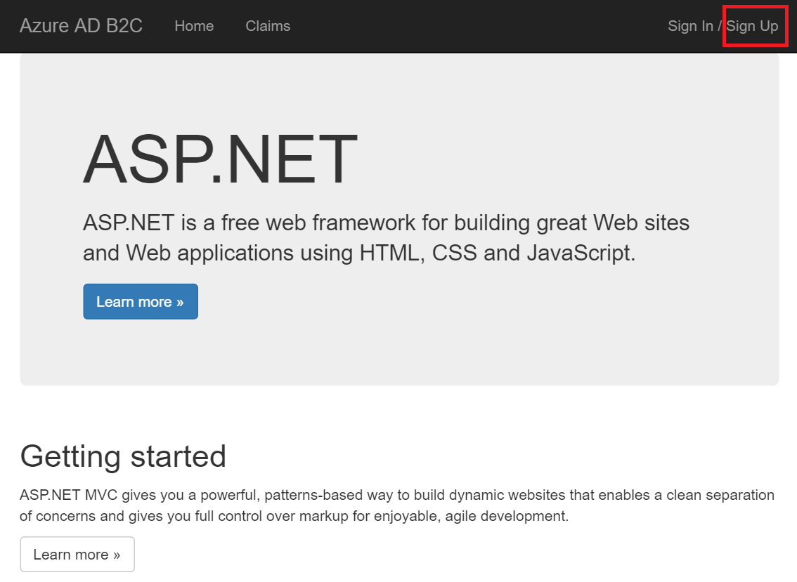
Sign-up via an application to access it

Slide 56
Graph Explorer

Slide 57
Demo
Personalization and MFA (with .NET app)

Slide 58
Summary

Slide 59


Seamless User Experience

Slide 60


Slide 61


Slide 62



Slide 63


CORS-site
XHR
WWW
http://domain-a.com
http://domain-b.com
CORS - aware Browser
Origin
CORS - aware web server
Cross Origin Resource Sharing

Slide 64
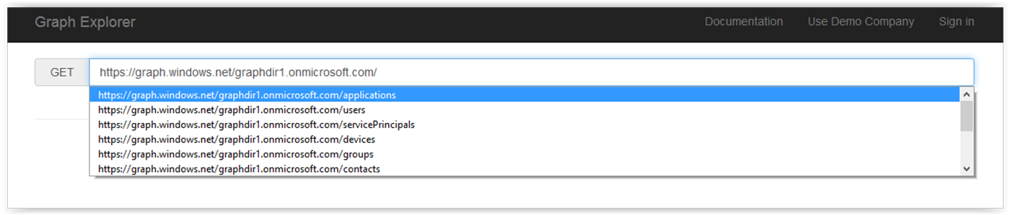
Internal tenant details

Slide 65
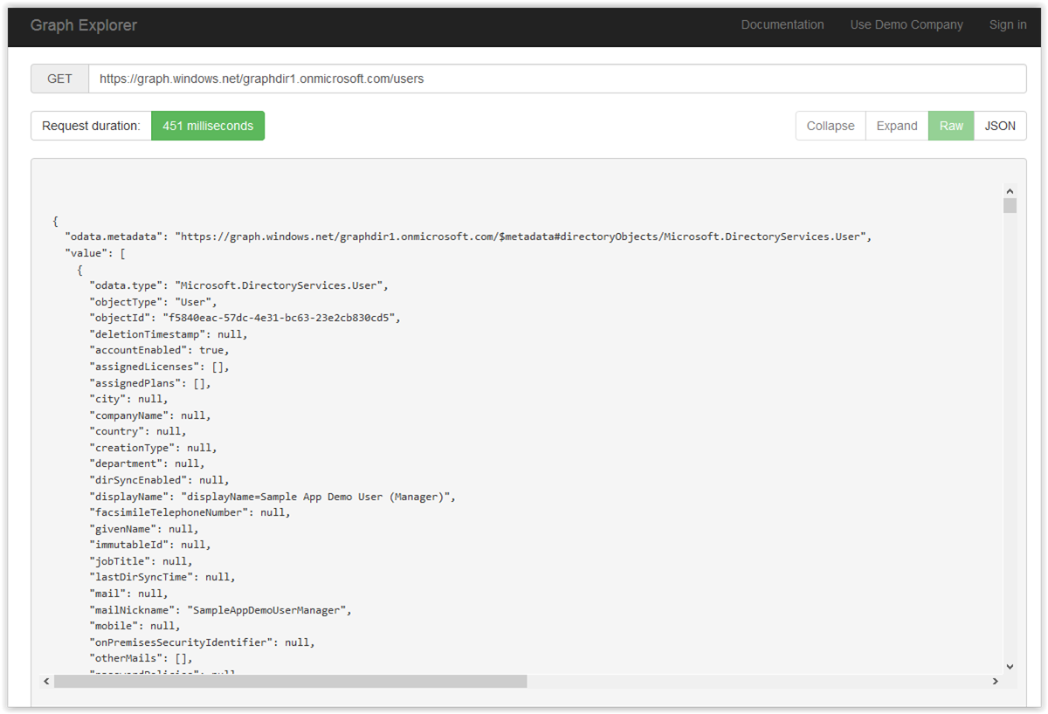
JSON attributes

Slide 66
Where does B2C fit?

Slide 67
Extending B2C
External User
WS-Fed / SAML / OIDC

Slide 68

Extending B2C
SaaS
External User

Slide 69
Extending B2C
SaaS
External User
Internal Application

Slide 70
Extending B2C
WS-Fed / SAML / OIDC
SaaS
External User
Identity Server
WS-Fed / SAML / OIDC
Internal Application

Slide 71
Extending B2C
WS-Fed / SAML / OIDC
SaaS
OIDC (Extended)
External User
Identity Server
Azure AD B2C
WS-Fed / SAML / OIDC
Internal Application

Slide 72
Extending B2C
WS-Fed / SAML / OIDC
SaaS
OIDC (Extended)
External User
Identity Server
Azure AD B2C
WS-Fed / SAML / OIDC
Internal Application

Slide 73
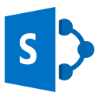
Extending B2C with SharePoint
Open ID connect
WS-Fed / SAML 1.1
External User
SharePoint on-prem / IaaS
Identity Server 3
Azure AD B2C

Slide 74
ADFS 4.0?
WS-Fed / SAML / OIDC
OIDC (Extended)
Saas
WS-Fed / SAML
External User
ADFS
Identity Server
Azure AD B2C
WS-Fed / SAML / OIDC
Internal Application

Slide 75
Pricing

Slide 76
Stored User /
Month
Authentications/ Month
Multi-Factor
Authentication
Free
First 50,000
Free
First 50,000
$ 0.0448
Per
Authentication
$ 0.00164
Next 950,000
$ 0.00418
Next 950,000
For the first 100,000 users, this is NZ$82 / month plus NZ$209 / month = NZ$291 / month
For subsequent slots of 100,000 users, this is NZ$164 / month plus NZ$418 / month = NZ$582 / month

Slide 77
Summary

Slide 78
Pros
External user capability OOTB
Minimum help desk involvement
Page look and feel can be customised
Customised reset password
Don’t have to roll your own
(security!)
SSO
Cons
No WS-Fed / SAML 2.0 support
No SaaS integration
Not a “normal” AAD tenant
Extended OAuth2
No AD Connect
Can’t add other social providers

Slide 79
Pros
External user capability OOTB
Minimum help desk involvement
Self-service password reset
Page look and feel can be customised
Don’t have to roll your own
(security!)
SSO

Slide 80
Cons
No WS-Fed / SAML 2.0 support
No SaaS integration
Not a “normal” AAD tenant
Extended OAuth2
No AAD Connect
Can’t add other social providers

Slide 81
Remember!
You can add users from other tenants for admin purposes
BUT
The best way to think about B2C is that only those users that signed up using B2C in the first place are the ones that can sign in to an application using it.

Slide 82
Remember!
You can add users from other tenants for admin purposes
BUT
The best way to think about B2C is that only those users that signed up using B2C in the first place are the ones that can sign in to an application using it.

Slide 83

“Azure Active Directory B2C helps us bring the stadium closer to our 450 million fans around the globe with simplified registration and login through social accounts, like Facebook, or traditional username/passwords login.”
RAFAEL DE LOS SANTOS
HEAD OF DIGITAL REAL MADRID
Provided a seamless experience across mobile applications on any platform
Built a fully customized login page without custom code
Alleviated concerns about security, data breaches, and scalability

Slide 84
It’s a wrap

Slide 85
Azure Active Directory B2C helps you to guard your external users in an ever evolving threat landscape

Slide 86
Resources
Azure AD B2C - https://azure.microsoft.com/en-us/documentation/services/active-directory-b2c/
Azure AD B2C limitations - https://azure.microsoft.com/en-us/documentation/articles/active-directory-b2c-limitations/
NET Web App sample - https://azure.microsoft.com/en-us/documentation/articles/active-directory-b2c-devquickstarts-web-dotnet/
Easy Auth - https://cgillum.tech/2016/05/27/app-service-auth-and-azure-ad-b2c/
Graph Explorer - https://graphexplorer.cloudapp.net/
.Graph Explorer (new) - https://graph.microsoft.io/en-us/graph-explorer#
SharePoint: https://oren.codes/2016/09/08/connecting-sharepoint-to-azure-ad-b2c/

Slide 87
Acknowledgement
Icon - https://icons8.com/
https://thenounproject.com/

Slide 88
The end
But feel free to ask questions

Slide 89
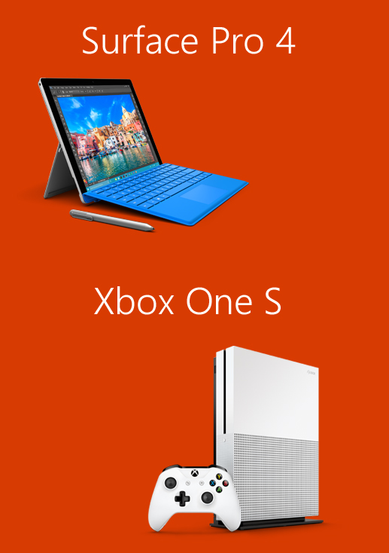
Please evaluate this session for the chance to instantly win great prizes like Surface Pro 4 and the brand new Xbox One S!
Your feedback is important to us!
From your PC or Tablet visit My Ignite at http://msignite.nz/my-ignite

